Slide 1
Recurrent Neural Networks (RNNs)
Artificial Intelligence
Notes:
Welcome to the presentation on Recurrent Neural Networks, a crucial component of Artificial Intelligence. Today, we will explore what RNNs are, their architecture, variants, applications, and limitations. We will also delve into real-world examples and discuss the future of RNNs.

Slide 2
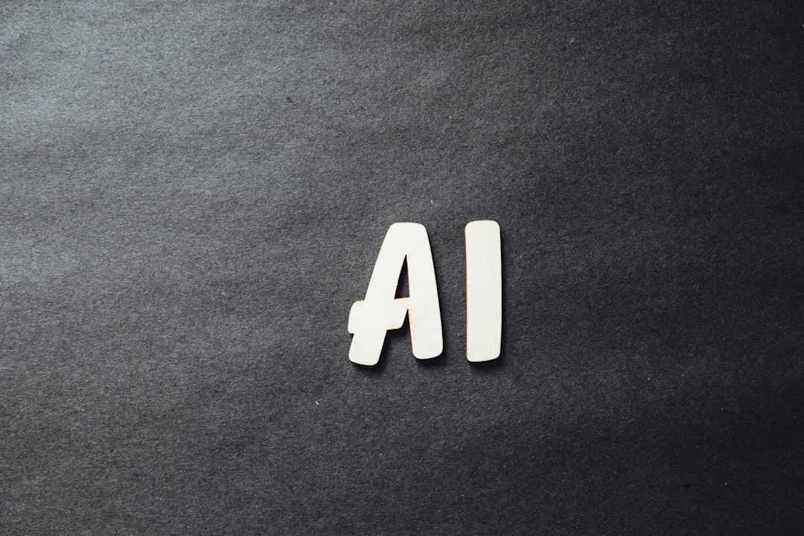
Introduction and Background
RNNs process sequential data
Used in speech recognition, language translation
Inspired by human brain structure
Can learn from experience and adapt
Key to many AI applications
Helps in understanding sequential patterns
Has many variants and applications
Important for natural language processing
Enables machines to learn from data
Notes:
Explain the importance of RNNs in processing sequential data and their applications in speech recognition and language translation. Provide examples of how RNNs are inspired by the human brain structure and can learn from experience. Ask students to think of other areas where RNNs can be applied.

Slide 3
Architecture and Key Equation
Feedback connections allow recurrence
Image_query: basic RNN architecture
Equation: h_t = tanh(W*x_t + U*h_(t-1))
Simple RNNs have limited capacity
More complex variants exist
RNNs can be trained using backpropagation
Vanishing gradients are a common issue
Need for more powerful variants arose
Notes:
Explain the basic architecture of RNNs, including feedback connections and recurrence. Show the image of the basic RNN architecture and provide the key equation. Discuss the limitations of simple RNNs and the need for more complex variants. Ask students to think about how RNNs can be trained and what issues they may encounter.

Slide 4
Variants of RNNs
LSTM (Long Short-Term Memory) networks
GRU (Gated Recurrent Unit) networks
Bidirectional RNNs
Deep RNNs
Residual RNNs
Attention-based RNNs
Recurrent Highway Networks
Gated Orthogonal Recurrent Units
Notes:
Discuss the different variants of RNNs, including LSTM, GRU, and bidirectional RNNs. Explain the advantages and disadvantages of each variant and provide examples of their applications. Ask students to think about which variant would be most suitable for a particular problem.

Slide 5
Applications and Advantages/Limitations
Speech recognition and synthesis
Language translation and generation
Text summarization and sentiment analysis
Time series forecasting and prediction
Advantage: can learn from sequential data
Limitation: vanishing gradients and overfitting
Can be used for recommender systems
Helps in natural language processing tasks
Notes:
Explain the various applications of RNNs, including speech recognition, language translation, and text summarization. Discuss the advantages of RNNs, such as their ability to learn from sequential data. Also, discuss the limitations, including vanishing gradients and overfitting. Ask students to think about how RNNs can be used in other areas, such as recommender systems.

Slide 6
LSTM Networks
Introduced to address vanishing gradients
Use memory cells and gates
Can learn long-term dependencies
Widely used in many applications
Can be used for sequence classification
Can be used for sequence generation
More powerful than simple RNNs
Require more computational resources
Notes:
Explain the concept of LSTM networks and how they address the issue of vanishing gradients. Discuss the use of memory cells and gates in LSTMs and their ability to learn long-term dependencies. Provide examples of how LSTMs are used in various applications, including sequence classification and generation.

Slide 7
GRU Networks
Simpler than LSTM networks
Use fewer parameters and gates
Can learn long-term dependencies
Faster to train than LSTMs
Can be used for sequence classification
Can be used for sequence generation
Less powerful than LSTMs
Require less computational resources
Notes:
Explain the concept of GRU networks and how they differ from LSTMs. Discuss the advantages and disadvantages of GRUs, including their simplicity, speed, and limited power. Provide examples of how GRUs are used in various applications, including sequence classification and generation.

Slide 8
Real-World Examples
Google Translate uses RNNs
Siri and Alexa use RNNs
Self-driving cars use RNNs
Stock market prediction uses RNNs
Medical diagnosis uses RNNs
Music generation uses RNNs
Chatbots use RNNs
Virtual assistants use RNNs
Notes:
Provide real-world examples of how RNNs are used in various applications, including Google Translate, Siri, and self-driving cars. Discuss the impact of RNNs on these applications and how they have improved their performance. Ask students to think about other areas where RNNs can be applied.

Slide 9
Future of RNNs
Will continue to improve with advancements
Will be used in more applications
Will be combined with other AI techniques
Will be used for more complex tasks
Will require more computational resources
Will be used in edge devices
Will be used in real-time applications
Will be more secure and reliable
Notes:
Discuss the future of RNNs and how they will continue to improve with advancements in technology. Explain how RNNs will be used in more applications and combined with other AI techniques. Provide examples of how RNNs will be used in edge devices and real-time applications. Ask students to think about the potential challenges and limitations of RNNs in the future.

Slide 10
Summary
RNNs process sequential data
Feedback connections allow recurrence
LSTM (Long Short-Term Memory) networks
Speech recognition and synthesis
Introduced to address vanishing gradients
Notes:
Summarize the key takeaways from the presentation, including the importance of RNNs, their variants, and applications. Discuss the future of RNNs and their potential challenges and limitations. Ask students to reflect on what they have learned and think about how they can apply RNNs in their own projects.

